Slide 1
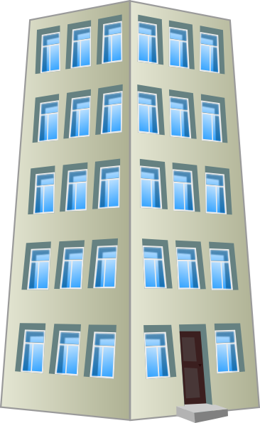
Breithaupt Block Three Fundraising Event
Descendants Brew Pub
Sunday, April 14th from 2 to 5 pm
Drop by to have a brewed-on-site craft beverage and at the same time help us raise funds for the BB3 appeal.
$10 admission with all proceeds going to the Fundraising Campaign.
Free face painting for the kids. And, local musicians will be there to entertain you.
You do not have to be a resident of Midtown to attend. Please feel free to invite your friends, your neighbours, your co-workers or anyone else who is happy that we were successful in our appeal on the Breithaupt Block Three build (BB3).
Descendants is located at 319 Victoria Street North
(near Jimmy’s lunch).
If you can’t make it you can contribute to the fundraising through gofundme
Mount Hope Midtown Neighbourhood
This Photo by Unknown Author is licensed under CC BY-NC
This Photo by Unknown Author is licensed under CC BY-SA
This Photo by Unknown Author is licensed under CC BY-SA

